Slide 1
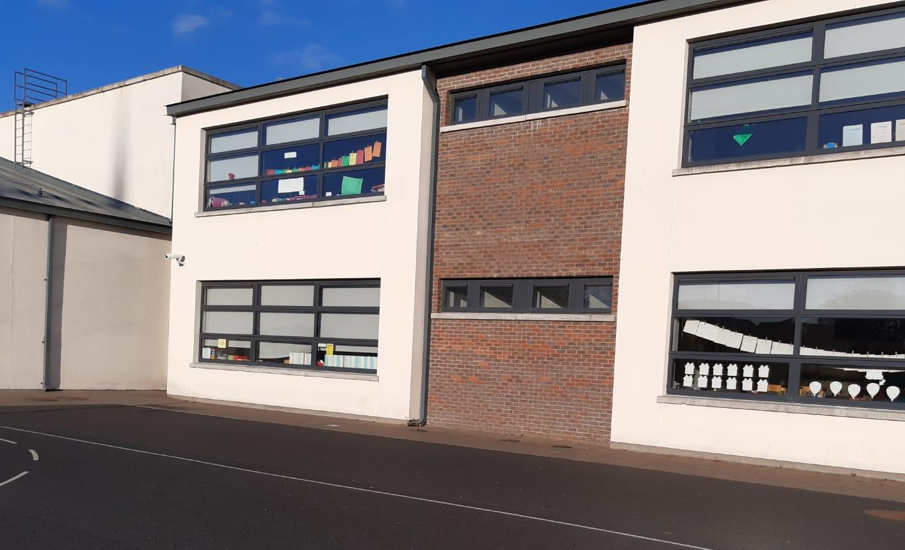
Welcome to Junior Infants
Sept.
2022
Scoil Bhríde (Cailíní)

Slide 2
Purpose of Presentation
To welcome parents to our school community.
To familiarise you with our school.
To outline general policies and work practices for the class.
To help you get ready for school in September.

Slide 3
Key staff
Principal - Paula Dargan
Assistant Principal – Anne McKeon
Secretary – Maeve Rispin

Slide 4
Our School
Scoil Bhríde is the original parish school of Blanchardstown. It began life in the mid-nineteenth century in what is now the hall of the Community Centre.
In September 2013, we made the move to our new school with its state of the art facilities.
Scoil Bhríde (Cailíní) is a diverse all girls primary school. At present, we have 1 special class and 14 mainstream classes comprising all levels, from Junior Infants to Sixth Class.
We have 323 students and 31 staff members.
Our motto is: Let us treat others as we would like them to treat us.

Slide 5
Our Mission Statement
To promote the fullest possible development of each child as an individual and as a member of society.
To promote attitudes and habits related to spiritual fulfilment and to ensure a sound social, moral and religious development.
To encourage the child to be self-confident, independent, tolerant, kind and co- operative and to ensure that pupils in Scoil Bhríde (Cailíní) achieve high standards of work and behaviour in a purposeful, quiet and organised manner.
To endeavour to ensure a good command of the Irish language and to promote a proper understanding of our Irish culture and nationality so that they may become proud of our rich heritage.
To endeavour to ensure that, at a minimum, each child will achieve a competence, appropriate to her ability, in literacy and basic mathematical concepts and operations.
To enable pupils to see themselves as members of both their local and global communities by encouraging awareness and understanding of their local environment and the wider world.
To ensure that all activities, policies and programmes are developed and delivered with respect and that a positive celebration of difference is cultivated, always being mindful of the moral, conscientious, religious, linguistic and cultural principles of all within the school community.

Slide 6
Home Languages
At Scoil Bhríde (Cailíní) we are very lucky to have such a rich linguistic environment. Our students can speak more than 40 different languages!
Speaking in your home language is important – it is an integral part of your cultural heritage. It should be cherished and passed on from generation to generation.
We would encourage you to read to your daughter in your own language and to speak to her at home and about school, in this language.
A strong first language is the foundation for learning other languages (English, Irish).
We aim to develop the children’s awareness of language and to foster interest and curiosity, not only in their own language, but also in the languages of others.

Slide 7
Here’s a Tour of Our School…

Slide 8
Junior Infant Classroom

Slide 9
Junior Infant Classroom

Slide 10
Junior Infant Classroom

Slide 11
Classroom Bathrooms

Slide 12
Our Yard
This is the yard where the girls line up in the morning. School begins at 8.50am
(Supervision is not provided before this time.)

Slide 13
End of Day Pick Up
Infant classes are brought by their teacher via this door to the Infant Gate and are dismissed one by one to a parent or designated adult.

Slide 14
Astro Turf pitches
Infant classes have play time on the Astro Turf pitches.
They play outside twice a day – at 10.40 am and 12.30 pm, weather permitting.

Slide 15
Our PE Hall

Slide 16
Our Library

Slide 17
Starting School

Slide 18
Smooth Transition
Role of the parents
Role of the school
Partners in the process

Slide 19
Role of the parents
Key person in the transition
Talk to school – concerns/worries, any specific needs
Talk to your child about the move
Positive message- Big school!
Some sample activities provided to get ready for school
Get involved in Parents’ Association

Slide 20
Role of the school
Ensure your child settles well/is happy
Clear communication- newsletter, texts, notes
Encourage child’s independence
Available to meet you by appointment
No concern too small to raise with us

Slide 21
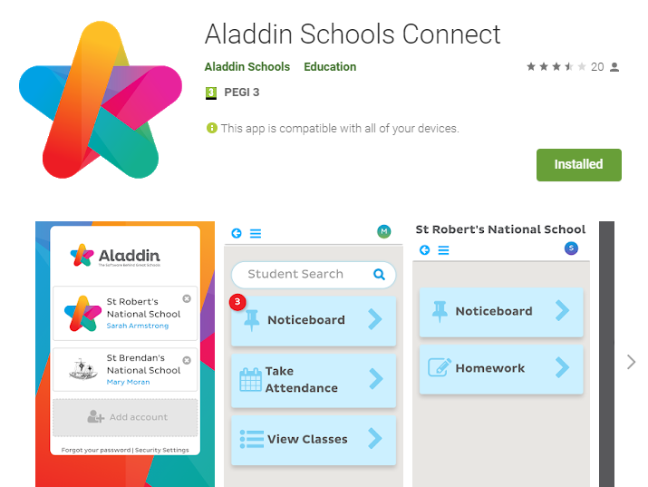
Communication
We use Aladdin Connect to communicate with parents.
We also send texts to parents.
Paper notes will be sent home sometimes.

Slide 22
Getting ready…
Develop fine motor skills – Lots of playdough, jigsaws and Lego.
Drawing and colouring pictures (using crayons/pencils).
Revise the alphabet, numbers, colours, nursery rhymes or any learning covered in preschool (if applicable).

Slide 23
Encourage independence:
Key skills to practise
Putting on and taking off jumper, coat, (for winter: hat, scarf, gloves etc.)
Putting on shoes (velcro instead of laces is advisable)
Opening and closing lunch box and bottle
Zipping and putting on school bag
Using the toilet
Washing hands with soap

Slide 24
School Uniform
Our school uniforms are available to purchase in Leddy Uniforms, Blanchardstown Village or Happy Events in Blanchardstown Centre.
Full school uniform – navy cardigan/jumper, light blue shirt, grey pinafore/skirt/trousers, navy tie with blue stripe, comfortable black shoes.
School Tracksuit or plain navy tracksuit , pale blue polo shirt and runners.
Sew-on school crests are also available in Happy Events, or Leddy Uniforms.
Uniforms must be worn everyday and tracksuit on P.E. days.
Please label every item of clothing.

Slide 25
Materials
School bag -should be big enough to fit an A4 size book and lunch.
Book list will be sent out by June.
Books to be paid for online by June 23rd and books will be available for you in September.
School will have materials -pencils, crayons etc. No need for pencil case.
Please label all items clearly.
Healthy Eating Policy in school.
Lunch box – practise opening and closing fully.
Reusable water bottle – practise opening and closing properly.
School no waste policy – all rubbish will go home in lunch box.
Welcome to
Scoil Bhríde Cailíní

Slide 26
Primary Curriculum
12 curriculum subjects: English, Irish, Maths, Geography, History, Science, Art, Music, Drama, P.E., S.P.H.E., Religious Education
Aistear – the play structured play curriculum
Many of these subjects are taught together through play and discovery.

Slide 27
School Day
Normal school day for infants
8:50am – 1:30pm
In September we start with a shorter day and then gradually phase in the longer day.
You will already have received exact details of this in your child’s starter pack.
We will keep you updated via Aladdin, should we receive any updates or guidelines from the DES over the summer months.

Slide 28
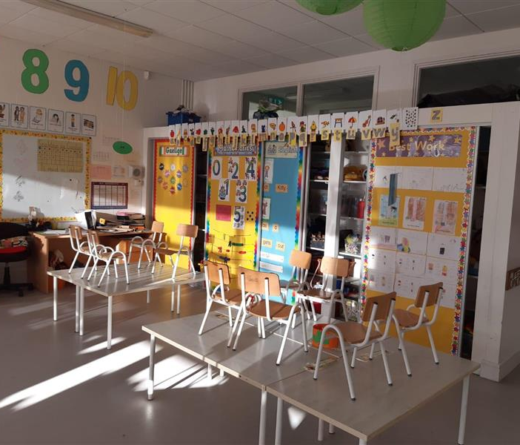
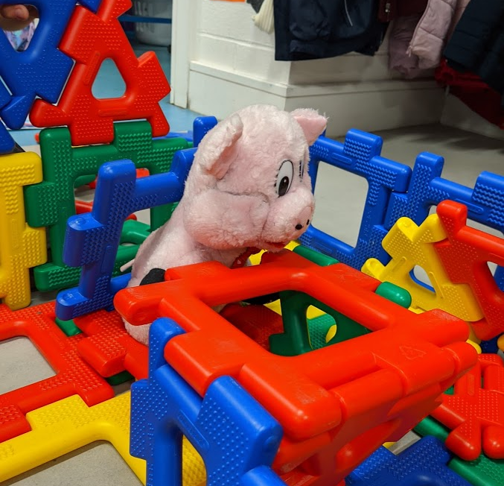
A Typical Day
This is an example of what a day in
Junior Infants might look like…
8:50am: Line up in yard and walk into class
Aistear (structured play), classes
10:40am: Morning snack and break (yard)
11:00am: Classes
12:20pm: Lunchtime, then break (yard)
12.50pm: Afternoon activity
1:30pm: Home time!

Slide 29
Home Time Procedure
At home time, parents wait outside the gate for their child's class to come to the gate with the teacher.
Classes come to the gate in line and teachers release children one-by-one to parents.
If you wish to speak with the class teacher, please wait until after all children are released and the teacher is free to speak with you.
If a different family member or child minder will be collecting your daughter, the school needs to be informed of this in advance.

Slide 30
Afterschool Activities
Afterschool Childcare (on site)
Little Stars Creche
Afterschool activities for infants
Irish dancing classes
Afterschool for older children
Irish dancing classes
Gaelic football/Camogie
Basketball
Athletics
Tin Whistle
Welcome to
Scoil Bhríde Cailíní

Slide 31
Thank You
We can't wait to meet you in September!
Enjoy the summer.
Slán go fóill.
Paula Dargan
Welcome to
Scoil Bhríde Cailíní

